Slide 1

Advantages and Disadvantages of Information Technology
Salman sami
Twana nareman
Shanya jafar
Meer omed

Slide 2
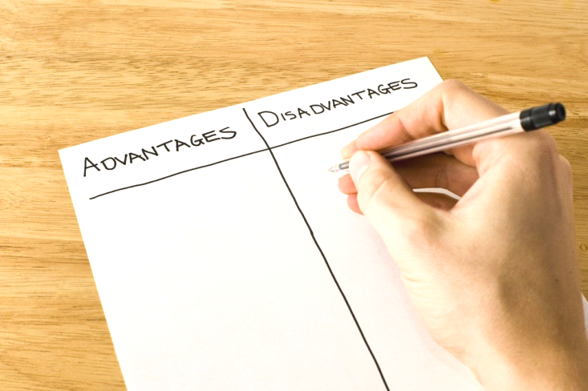
Outline :
Advantages and Disadvantages of information technology in Purchasing
Advantages and Disadvantages of information technology in Society
Advantages and Disadvantages of information technology in Business
Advantages and Disadvantages of information technology in Banking

Slide 3

Advantages and Disadvantages of information technology in Purchasing

Slide 4
Disadvantages:
Internet security issues: For the merchant to process an order online, a consumer has to provide their financial details. Experienced hackers can use this lop hole to channel this information and use it for their own needs.
Faulty products and duplication: In most cases auction websites have products that are not real. So a user can bid on a shoe thinking it is original, upon delivery, they discover that the shoe is fake and it does not resemble the picture on auction.
Privacy – ecommerce websites collect personal data using cookies to know more about us and suggest products basing on that information. This data is collected without any notice , but with selfish intent.

Slide 5
Advantages:
Credit Cards and Smart cards: Buying and selling of goods and services has become simple because of these smart cards. A user can go to a merchant’s website and make an order using their smart card or credit card. Money will be transferred from the consumers account to the merchants account in seconds, and then the merchant will deliver the item to the consumers address. This saves time for both parties.
Electronic Bill Presentation and Payment: (EBPP) systems send us bills over the internet and they give us an easy way to pay them if the amount looks correct. In this there is need for billing companies to send our bills in mail. It saves time for both parties.
More time - IT has made it possible for businesses to be open 24 x7 all over the globe. This means that a business can be open anytime anywhere, making purchases from different countries easier and more convenient. It also means that you can have your goods delivered right to your doorstep with having to move a single musc

Slide 6
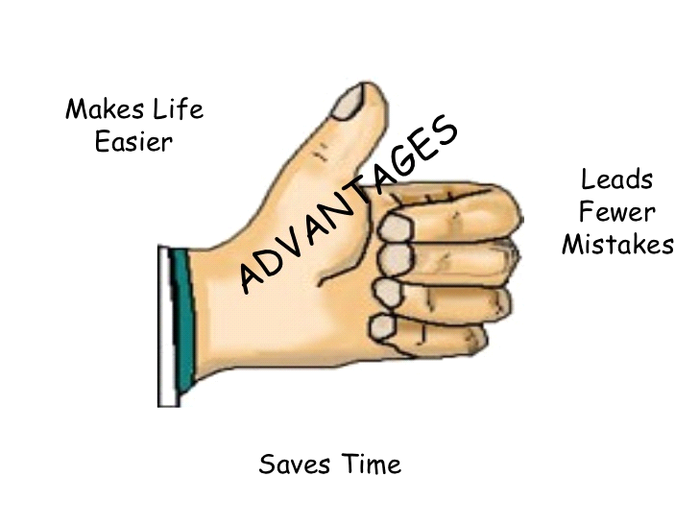
Advantages and Disadvantages of information technology in Society

Slide 7
New methods of education have been created – Use of educational video games and puzzles has increased students interest in learning. Basing on research, students enjoy learning with technology, many schools have started providing free internet on school campus,
Globalization - IT has not only brought the world closer together, but it has allowed the world's economy to become a single interdependent system. This means that we can not only share information quickly and efficiently, but we can also bring down barriers of linguistic and geographic boundaries.
Bridging the cultural gap - Information technology has helped to bridge the cultural gap by helping people from different cultures to communicate with one another, and allow for the exchange of views and ideas, thus increasing awareness and reducing prejudice.

Slide 8
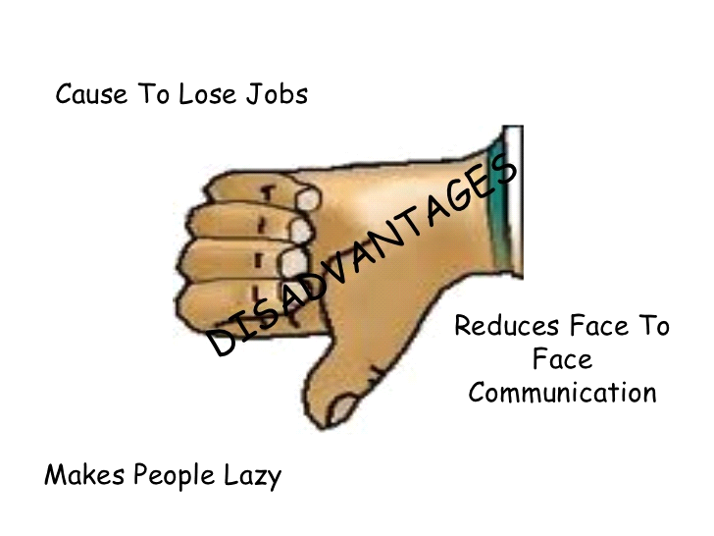

Slide 9
Disadvantage
Over dependence on information technology makes students less active and innovative.Students no longer take time to solve equation and tasks, all they do is query that task in a search engine and a solution will be provided.
Poor publications online: This exposes student’s t wrong information which results into failure of exams. Many online publishers post content for monetary purposes, so you find that most the content published online is not well detailed to help students and researchers.
Unemployment - While information technology may have streamlined the business process it has also crated job redundancies, downsizing and outsourcing. This means that a lot of lower and middle level jobs have been done away with causing more people to become unemployed.

Slide 10
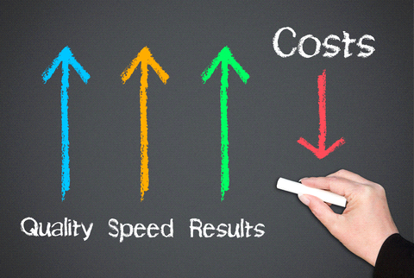
Advantages and Disadvantages of information technology in Business

Slide 11
Advantage
Increases production and saves time: Business use technology to automate tasks. A good example is a bakery which uses automated temperature censors to detect any drop or increase in room temperature in a bakery. These censors will send information directly to the operator and report any temperature change. This saves the bakery time and it also results into quality products.
Improves financial management: Accounting software like Quick Books , Bookkeeper , Sage 50 , and Account Edge can be used in performing various accounting tasks in a business. Business owners can easily balance their books with less experience in accounting because these software’s are well equipped with every tool needed in accounting and they also have a help section which can be referred to in case a user is stuck.

Slide 12
Disadvantage
Expenses : Having cutting-edge technology is an ongoing expense. There are initial purchasing costs, as well as ongoing maintenance, updates and training expenses. Should a system failure occur, loss of revenue can result due to loss of services rendered or product production halted.
No Time for Yourself : The always-on state of technology has blurred the lines between work and personal time. A 2012 survey of executives conducted by Forbes Insights found that 98 percent send work-related emails at night and during weekends, while 38 percent deal with business matters even while on vacation, and more than half occasionally or regularly step away from meals and family gatherings to do so. Although this can increase productivity, it also increases stress and frustration.

Slide 13
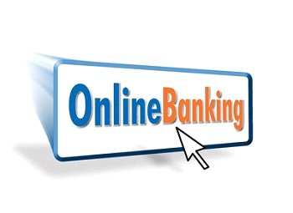
Advantages and Disadvantages of information technology in Banking

Slide 14
Advantages:
Online Banking: Many banks have integrated advanced information technology systems to improve on their customer service. Today, it is very easy to withdraw money using an ATM card or smart money card, this saves customers from wasting time lining up in banks.
Fast Credit: Technology used in banks helps in gathering of financial details and credit scores about each customer, the information gathered can be used when a customer applies for credit in that bank.

Slide 15
Disadvantages:
Privacy - Though information technology may have made communication quicker, easier and more convenient, it has also bought along privacy issues. From cell phone signal interceptions to email hacking, people are now worried about their once private information becoming public knowledge.
Money Laundering: Cases of online money laundering are on the rise and this has exposed many online users to the predators.
Lack of job security - Industry experts

Slide 16
Thank you

